Slide 1

Criminal Records and Search System using String Matching Algorithms
CSA0303 – Data Structures
Presented by:
Poojitha A (192511230)
Sabitha V (192421415)
Nandhini M (192472318)
Guide by:
Dr. T Rajesh Kumar
Professor
SIMATS Engineering

Slide 2
Abstract
Efficiently stores and manages criminal records in a structured database.
Uses string matching algorithms for fast and accurate search of names/data.
Reduces manual effort and improves investigation speed.
Ensures quick retrieval of matching records even in large datasets.
Enhances data accuracy and supports law enforcement decision-making.

Slide 3
Introduction
Criminal investigations require quick and accurate access to records.
Traditional keyword searches may fail with incomplete or misspelled names.
The proposed system uses string matching algorithms to improve search accuracy.
It supports searching criminal names, biometric patterns, and case histories.
The system helps law enforcement identify suspects efficiently.

Slide 4
Problem Statement
Large criminal databases are difficult to search manually.
Misspelled or partial suspect names reduce search accuracy.
Finding matching DNA or fingerprint patterns is time-consuming.
Crime descriptions are stored as unstructured text, making searches slow.
Existing systems struggle with fast and reliable pattern matching.

Slide 5
Objectives
Develop a fast criminal record search system.
Improve suspect identification using string matching algorithms.
Detect partial and misspelled names accurately.
Match biometric patterns efficiently.
Search crime history using keyword-based indexing.
Reduce search time and improve investigation efficiency.

Slide 6
Methodology
Collect and store criminal records in a structured database.
Preprocess data (clean names, remove duplicates, standardize format).
Apply string matching algorithms (like Naive, KMP, or Rabin-Karp) for searching.
Compare input query with stored records to find matches quickly.
Display matched results efficiently for user/law enforcement use.

Slide 7
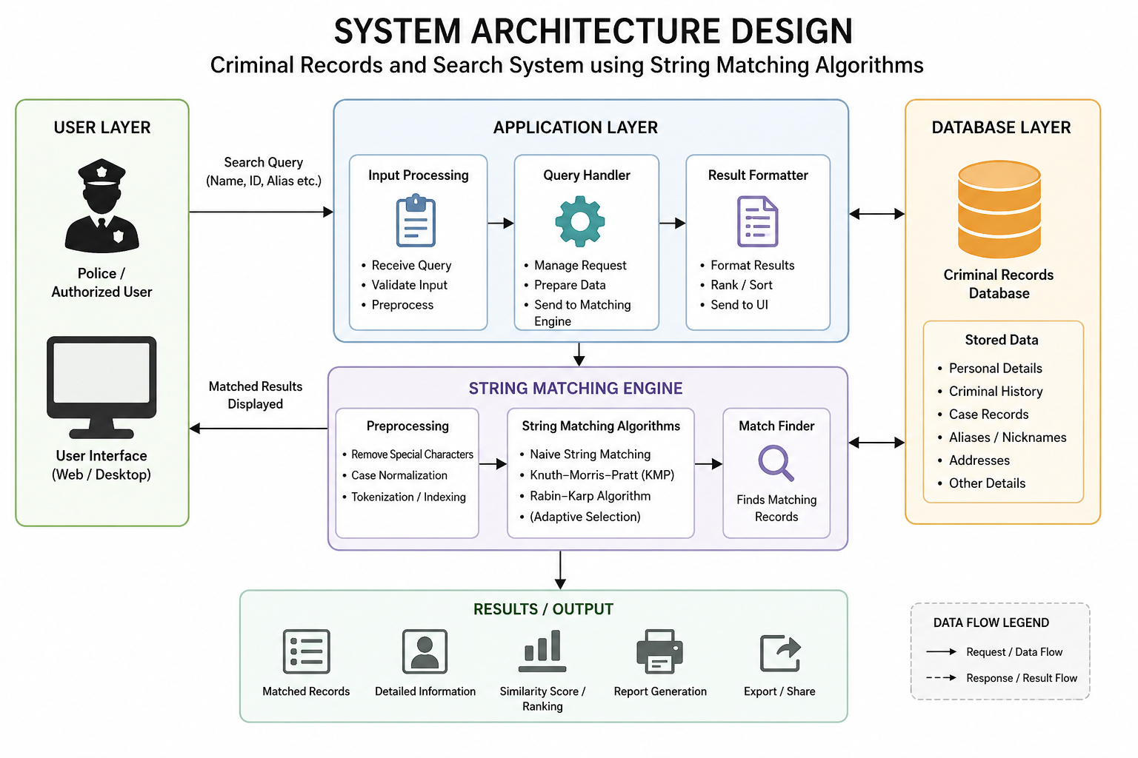
System Architecture

Slide 8
Module 1 – Alias & Name Matcher
Purpose
Detect suspects using complete, partial, or misspelled names.
Features
Fuzzy name search
Partial name matching
Alias detection
Fast search in large databases
Algorithm Used : Knuth-Morris-Pratt (KMP) Algorithm
Output Accurate suspect identification ,Reduced manual searching

Slide 9
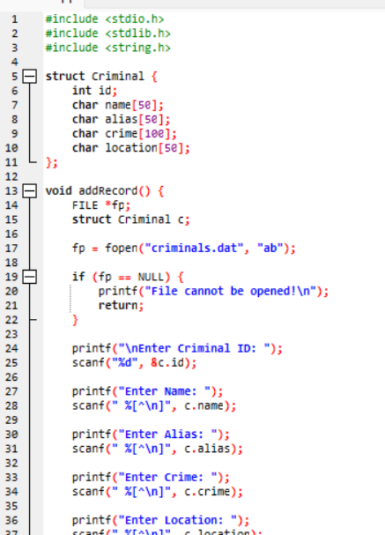
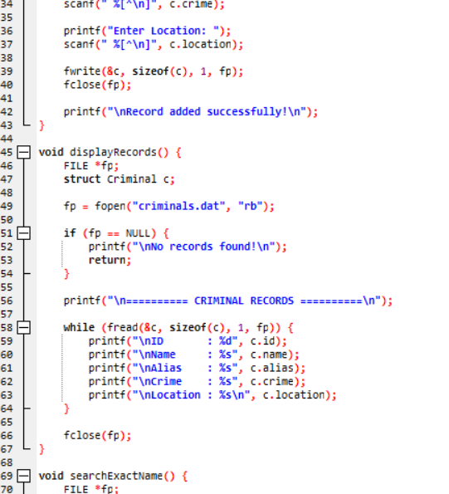
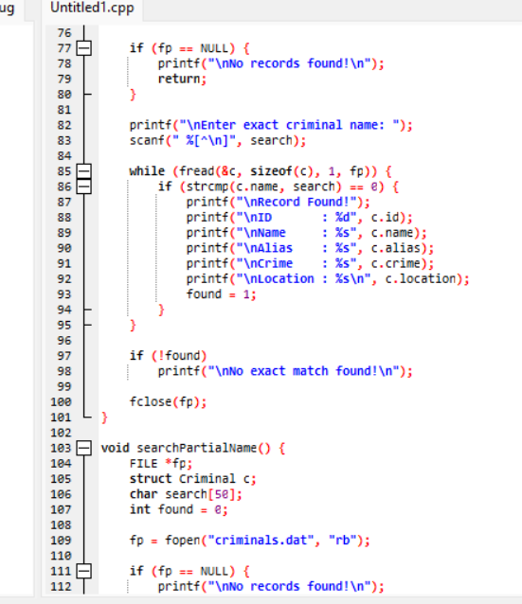

Slide 10
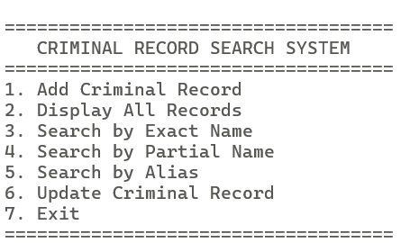
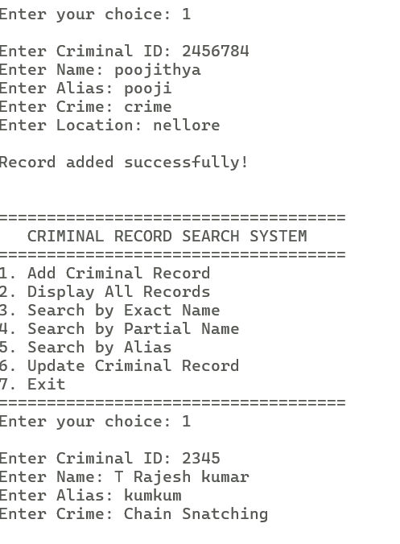
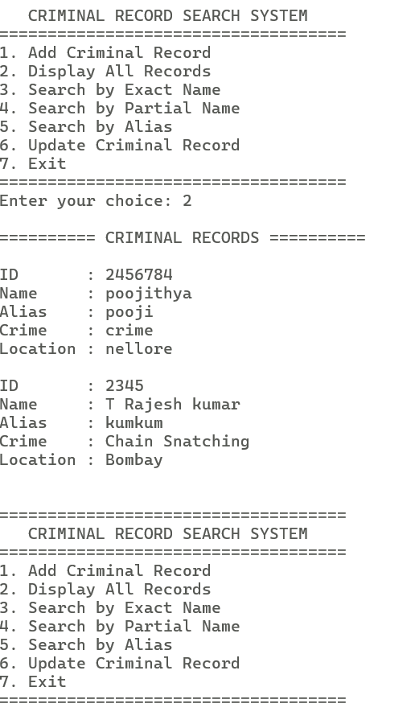

Slide 11
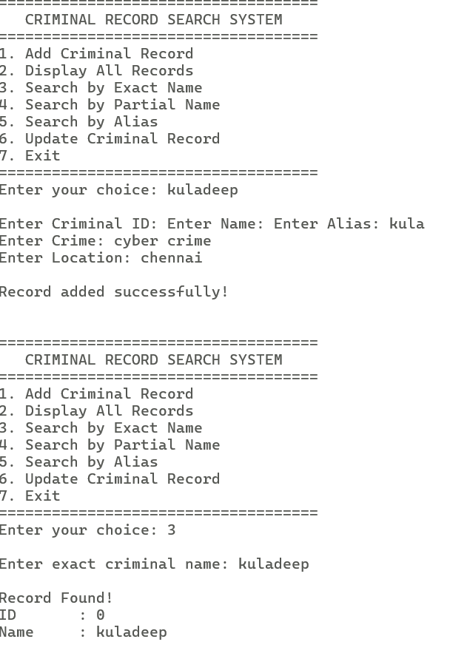
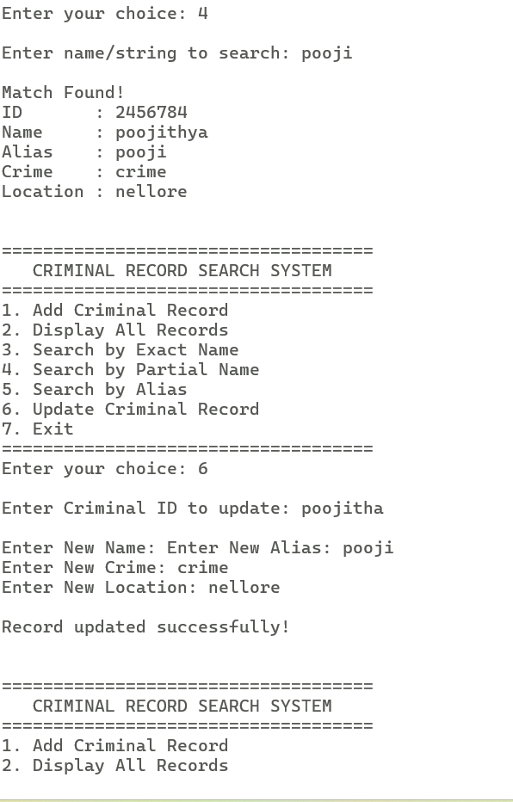

Slide 12
Module 2 – DNA/Fingerprint Pattern Search
Purpose
Compare biometric samples with stored criminal records.
Features
DNA sequence matching
Fingerprint pattern comparison
Large-scale biometric search
High-speed pattern recognition
Algorithm Used : Boyer-Moore Algorithm
Output Identify repeat offenders ,Faster biometric verification

Slide 13
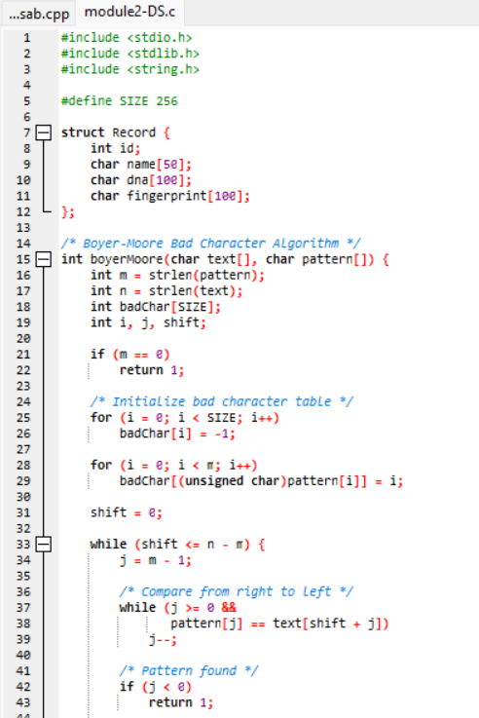
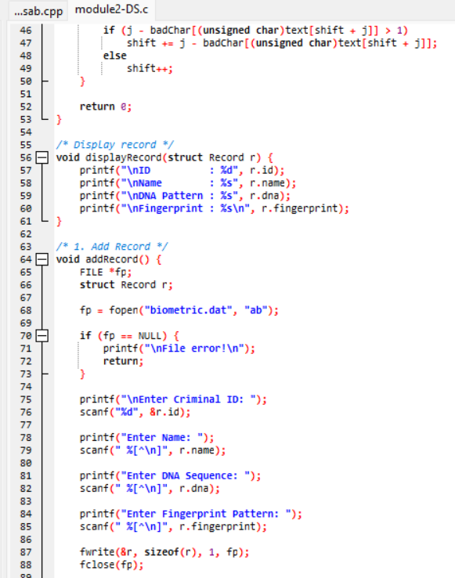
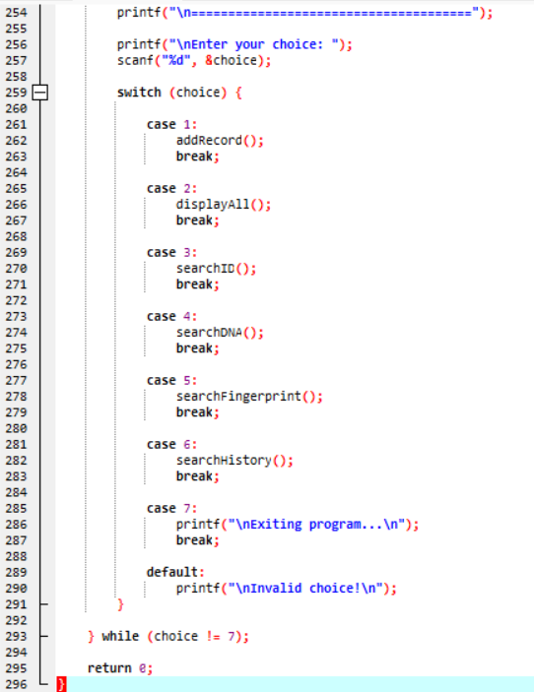

Slide 14
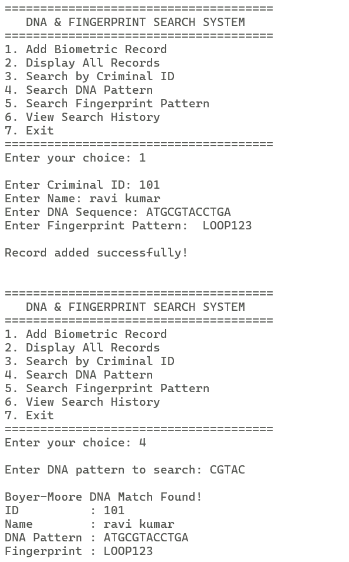
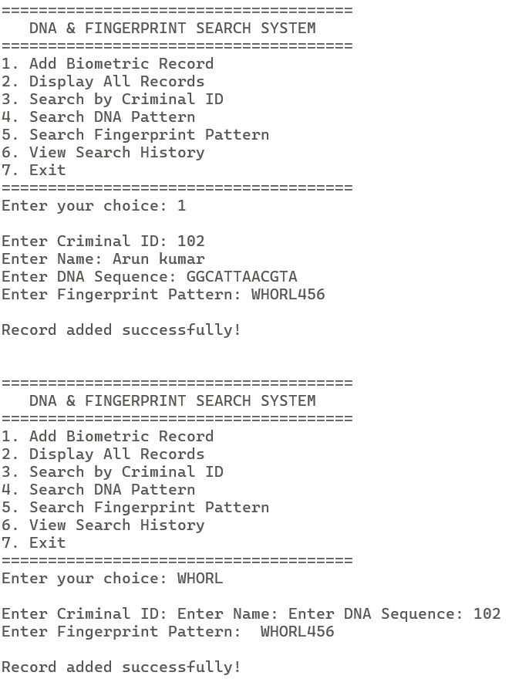
Sample output

Slide 15
Module 3 – Case History Indexer
Purpose
Search crime descriptions using keywords.
Features
Crime keyword search
Modus Operandi detection
Fast text scanning
Related case identification
Algorithm Used : Rabin-Karp Algorithm (Rolling Hash)
Output Quick retrieval of similar cases ,Better crime pattern analysis

Slide 16
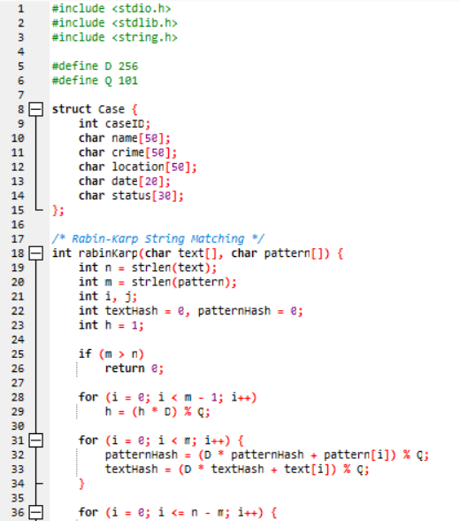
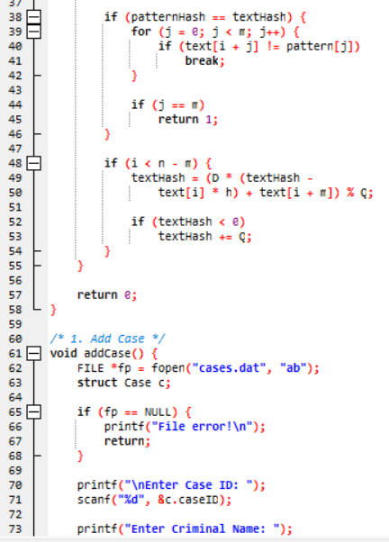
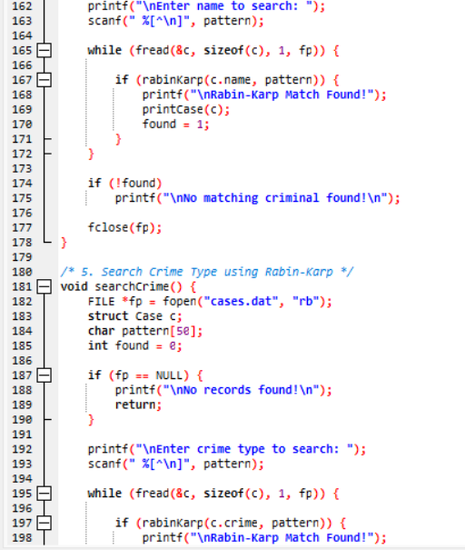

Slide 17
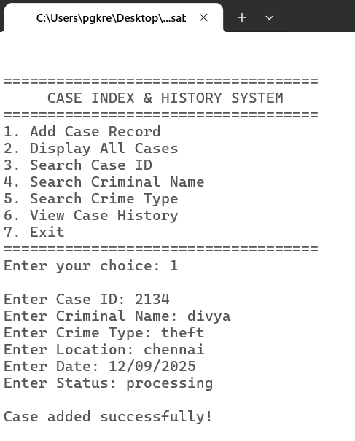

Slide 18
Results and Discussion
The proposed system provides a fast and intelligent criminal record search solution.
KMP improves name and alias matching accuracy.
Boyer-Moore enables efficient biometric pattern matching.
Rabin-Karp accelerates crime history searches.
The system reduces investigation time, improves search accuracy, and supports law enforcement in solving cases more effectively.

Slide 19
Future Scope
The system can be expanded to handle larger criminal databases efficiently.
Advanced matching techniques can improve search accuracy and speed.
It can be integrated with police databases for faster record access.
Mobile and web applications can make the system easier for authorized users.
Security features can be added to protect sensitive criminal records.

Slide 20
Conclusion
The proposed system provides a fast and intelligent criminal record search solution.
KMP improves name and alias matching accuracy.
Boyer-Moore enables efficient biometric pattern matching.
Rabin-Karp accelerates crime history searches.
The system reduces investigation time, improves search accuracy, and supports law enforcement in solving cases more effectively.

Slide 21
References
[1] Ministry of Home Affairs, Government of India, “Inter-Operable Criminal Justice System (ICJS),” Government of India, 2024.
[2] W. Z. Khan, M. K. Khan, A. Ahmad, and others, “Exact String Matching Algorithms: Survey, Issues, and Future Research Directions,” IEEE Access, vol. 7, pp. 69614–69637, 2019.
[3] J. D. Benny and S. Sathyan, “Text Pattern Searching Algorithm: Naive, KMP, Rabin Karp Comparative Study,” International Journal of Advanced Research in Science, Communication and Technology, 2022.
[4] R. S. Boyer and J. S. Moore, “A fast string searching algorithm,” Communications of the ACM, vol. 20, no. 10, pp. 762–772, Oct. 1977.
[5] D. E. Knuth, J. H. Morris, Jr., and V. R. Pratt, “Fast pattern matching in strings,” SIAM Journal on Computing, vol. 6, no. 2, pp. 323–350, Jun. 1977.

Slide 22
THANK YOU !

